Slide 1
Histogram of Oriented Gradients GNR602
Suryansh Patidar - 22B1036 Aakriti Chandra - 22B0908
Tanishk Mohan - 22B1812

Slide 2
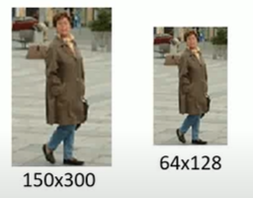
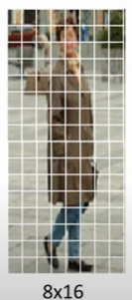
The histogram of oriented gradients (HOG) is a feature descriptor used in computer vision and image processing for the purpose of object detection.
Algorithm:
First, we resize the image to 64*128.
Next, we will divide the image in small blocks of size 8*8. We would also have to change the image into grayscale.
Ref - https://youtu.be/28xk5i1_7Zc?si=HgFwTplY-c6mMclv

Slide 3
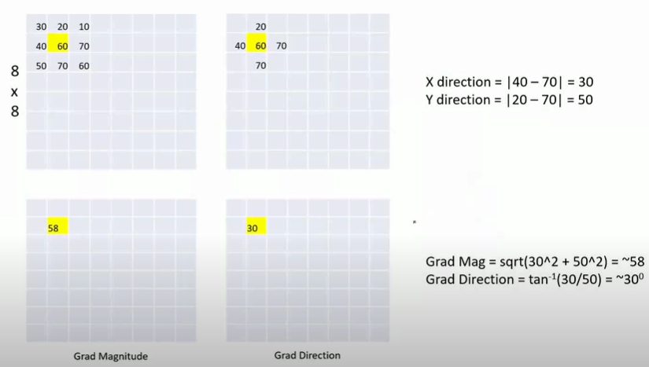
We now calculate gradient and magnitude value for each element of 8*8 matrix. Padding with zero values is done to ensure proper values for edge pixels.
A 1*9 feature vector is calculated for each 8*8 matrix with bin values ranging from 0 to 160 degrees.
Group of 4 such 8*8 cells are taken one at a time. We apply normalization on each value of feature vectors and then concatenate all four 1*9 feature vector.
Resulting 1*36 feature vector is stored for each group of 4, 8*8 matrix, after moving 1 step in horizontal and vertical direction.

Slide 4


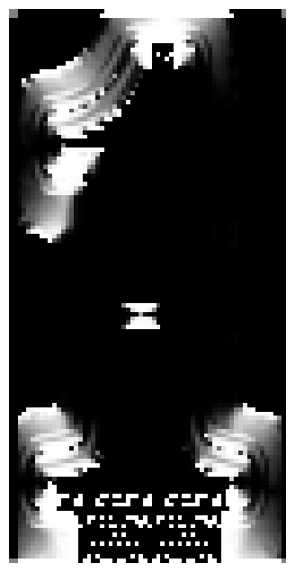
Now, we end up with a feature vector of size 7*15*36.
This is the final output which is used for object detection
Example of visualization of gradient magnitude and angle in a sample image:
Gradient magnitude
Angle

Slide 5
Our model
We are using support vector machine to classify the input image for one parameter (buildings).
We have modified the algorithm a little bit because of our training set dimensions.
Size of the image is 128*128, so the final feature vector is 15*15*36.
After flattening the feature vector, resulting array is of the size 1*8100.

Slide 6
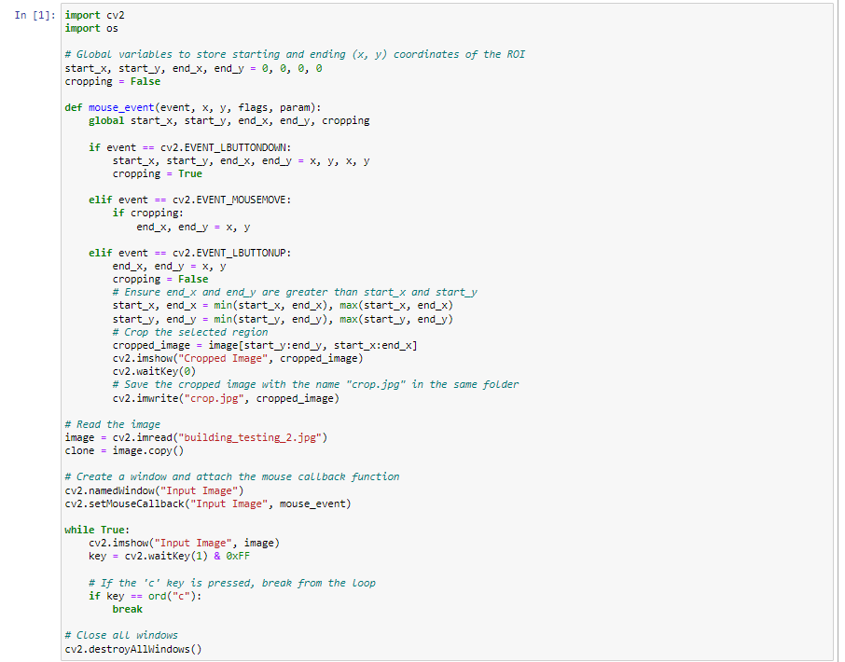
Testing on an Image
Our code takes an input image, then it let’s the user crop a particular area out of it and finally using the SVM classifier trained on a particular dataset, we get an output whether building is present in the cropped image or not.
Selecting the image:
After running this code, it let’s the user crop out a small part out of the image which is used as an input image in SVM classifier.

Slide 7
Testing on an Image (continued…)
Python file named training.ipynb labels the dataset that we are using here.
Another Python file named testing.ipynb will extract the feature vector of size 1*8100 out of that cropped image.
It will then train the SVM model on the labelled dataset and produce an output against the “cropped” input image.

Slide 8
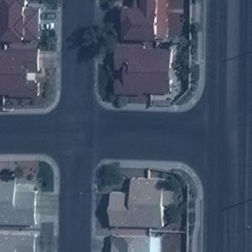


Testing on an Image (continued…)
Input Image
Cropped Image
Output

